Slide 1
“Co-Occurring Disorders and Recovery Support”
The Fletcher Group Presentation
July 2nd, 2026
Geoff Wilson, LCSW, LCADC, CCS

Slide 2
Agenda
1) Increase knowledge regarding the prevalence and severity of co-occurring mental health and substance use disorders in the US.
2) Discuss the impact these disorders have on the client and potential obstacles to the client for starting the recovery process.
3) Review additional best practices for intervention and treatment for the client struggling with co-occurring mental health and substance use disorders.

Slide 3
Co-occurring Disorders
The coexistence of both a mental health disorder and a substance use disorder (SUD) is referred to as co-occurring disorders.
Co-occurring disorders may include any combination of two or more SUDs and mental disorders identified in the Diagnostic and Statistical Manual of Mental Disorders, Fifth Edition (DSM-5-TR).
Importantly, no specific combinations of mental and substance use disorders are uniquely defined as co-occurring disorders.

Slide 4
Significant Symptoms of Substance Use Disorders in patients with Mental Health Disorder
*Enhanced Reinforcement
*Mood Change
*Escape
*Hopelessness
*Poor Judgment
*Inability to Appreciate Consequences

Slide 5
Results of Substance Use Disorder with Mental Health Disorder
*Lower medication adherence
*Greater chance of relapses
*Increased hospitalizations
*Homelessness
*Increased Suicide Risk

Slide 6
Co-occurring Issues Are Common!!
According to SAMHSA’s 2024 National Survey on Drug Use and Health (NSDUH), approximately 21.2 million adults had a co-occurring mental illness and substance use disorder.
People with mental illness are at a higher risk of developing an SUD compared to those without mental illness. Similarly, individuals with substance use disorders are particularly vulnerable to developing primary conditions or chronic diseases.

Slide 7
Common Co-occurring Disorders
The most common mental disorders:
Anxiety and mood disorders
Schizophrenia
Bipolar disorder
Major depressive disorder
Conduct disorders
Post-traumatic stress disorder
Attention deficit hyperactivity disorder
Patients being treated for mental disorders often misuse the following types of substances:
Alcohol
Tobacco
Opioids
Stimulants- Meth
Marijuana
Hallucinogens
Prescription drugs

Slide 8
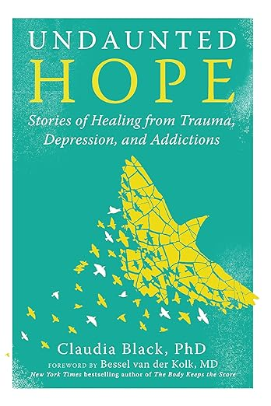

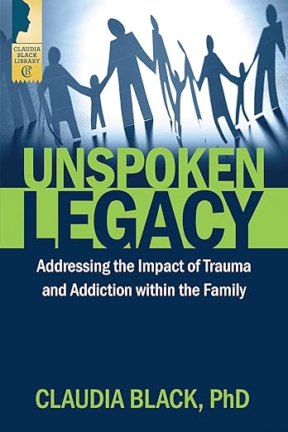
The Impact of Trauma
“If we are chronically dysregulated long enough, we tend to become “stuck” in a dysregulated state, regardless if the original “pain” is still present or not.” Claudia Black, Ph.D.

Slide 9
Autonomic Nervous System
On a daily basis, our nervous systems experience periods of increasing arousal and periods of decreasing arousal. Each one of us has a “Window of Tolerance” or an “Optimal Arousal Zone” where we can experience nervous system fluctuations while still having the capacity to regulate ourselves .
Optimal Arousal Zone
Present, embodied, open,
curious, tolerable feelings,
relaxed yet alert, able to
think, relational

Slide 10
Sympathetic Hyperarousal
Anxious, panic, restless, hyperactive, hypervigilant, exaggerated startle,
emotional flooding, impulsivity,
risk-taking, poor judgment
Dysregulated
Arousal
Regulated
Arousal
Optimal Arousal Zone
Present, embodied, open,
curious, tolerable feelings,
relaxed yet alert, able to
think, relational
Parasympathetic Hypoarousal
Flat affect, depression, lethargy,
numb, disconnected, dissociation,
despair, self-loathing, hopeless,
full of shame, victim identity

Slide 11
The more severely we are dysregulated, and/or the longer the dysregulation lasts, the greater the chance we subjectively experience unbearable discomfort, or difficulty staying “within our own skin”.
Many clients begin self-medicating in order to move away from the pain and move towards pleasure.

Slide 12

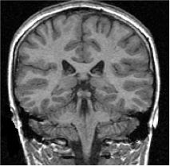
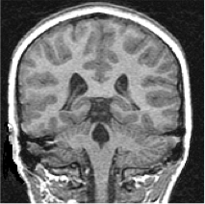
(De Bellis et al., 1999)
Notes:
This slide demonstrates the physical impact of trauma on the brain. This work comes from an important study by Dr. Michael DeBellis (pronounced: Bayless with a long ‘a’) and his colleagues that was published in Biological Psychiatry in 1999. Dr. DeBellis studied the brains of children who were abused and compared them to the brains of children who were not abused.
Dr. DeBellis found that the brains of children who had been abused were different. (Again, it might be helpful to use a laser pointer here.) If you look on the left side, the healthy child’s brain, you see a thin external layer covering the brain (white area arching over brain image). If you look at the image on the right, you see a thicker white band. This shows atrophy or shrinkage of the cerebral cortex. Besides the cortex, other structures of the brain change, like the hippocampus and the amygdala. These structures also decrease in size. But the lateral ventricles, on the other hand, increase in size in people who are traumatized. See this black triangle shapes on left image and how much larger they are in the MRI image of the child with trauma on the right? Trauma physically effects the brain and how it functions.
Karestan Koenen, a researcher from Boston, published a groundbreaking twin study in 2003. She looked at twins where one had a history of trauma and one did not. What she found was that the twin who had a trauma history, had on average, an 8-point reduction in IQ scores – the only distinguishing variable was the trauma. Lowered IQ is a significant risk factor for other negative outcomes, like school failure and juvenile delinquency. What this means is that people with trauma histories, can also have brains that have been adversely effected by that experience. So, trauma can directly effect learning and day-to-day functioning of the people we serve, for the rest of their lives.
Transition for next slide---To assist with this next part of our discussion, if you will reach down beneath your seat, and pull up you’ll find your hand attached to your risk and we’ll now have a handy model for the brain that we can use....go to next slide.

Slide 13
Long Term Effects of Trauma
In the absence of more positive coping strategies, people who have experienced trauma may engage in high risk or destructive behaviors.
These behaviors place them at risk for a range of serious mental and physical health concerns including: Alcohol and Other Drug Use Related Issues, Depression, Suicide Attempts, Sexually Transmitted Diseases, Heart Disease, Cancer, Chronic Lung Disease, Skeletal Fractures.
Give Your Clients an ACES Screening.

Slide 14
Trauma Informed Care
A definition of trauma-informed approach incorporates three key elements:
(1) Realizing the prevalence of trauma
(2) Recognizing how trauma affects all individuals involved with the program, organization, or system, including its own workforce
(3) Responding by putting this knowledge into practice

Slide 15
Universal Precautions as a Core Trauma Informed Concept
Presume that every person in your setting has been exposed to abuse, violence, neglect or other traumatic experiences!!!

Slide 16
What’s the History??
Sequential Treatment: I’m referred to one form of treatment, and once addressed, I’m referred to another form of treatment. Failed, but common even today.
Parallel Treatment: Treat them at the same time, in two different agencies or sights. If they attempt to talk, it’s called collaborative. This can be productive if everybody stays in consistent contact!!

Slide 17
What’s the History
“When substance disorder and psychiatric disorder co-exist, each disorder should be considered primary, and integrated dual primary treatment is recommended, where each disorder receives appropriately intensive diagnosis specific treatment.”
(K. Minkoff-”An Integrated Model for the Treatment of People with Co-Occurring Disorders in Managed Care Systems”).

Slide 18
Integrated Treatment:
*Provide for both in one place.
*Provider/Treatment team has varied backgrounds.
*Ideally provided by a cross-trained clinician.
*Responsive to the many changing symptoms and disorders of the patient

Slide 19
Why Integrated Treatment?
Among those with co-occurring disorders:
A common cause of psychiatric relapse is resumption of alcohol or drug USE, not necessarily abuse.
A common cause of relapse to alcohol and other drugs is untreated psychiatric disorders, especially depression and anxiety (Kessler, 1996.)

Slide 20
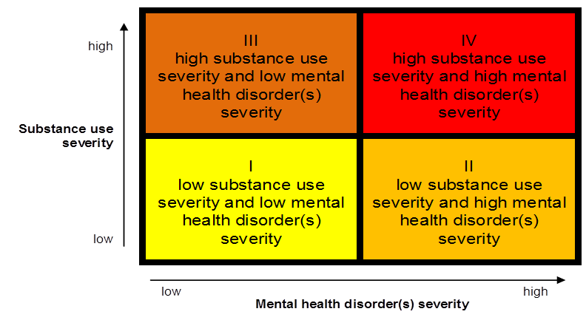
Quadrants of Care

Slide 21
Four Quadrants of Co-occurring Disorders
Category I: Less severe mental disorder/Less severe substance abuse disorder.
Locus of care: Primary health care settings-Outpatient treatment MH/SA.

Slide 22
Four Quadrants
Category II: More severe mental illness/Less severe substance use disorder.
Locus of care: Mental health system/integrated case mgt.

Slide 23
Four Quadrants of
Co-occurring Disorders
Category III: Less severe mental disorder/More severe substance abuse disorder.
Locus of Care: Substance abuse system/Coordination and collaboration with affiliated mental health programs.

Slide 24
Four Quadrants
Category IV: More severe mental disorder/More severe substance abuse disorder.
Locus of care: State hospitals, modified therapeutic communities, jails/prisons, emergency rooms, etc.

Slide 25
Six Guiding Principles in Treating Clients with COD
1. Employ a recovery perspective
Recovery is a long-term process of internal change, and it recognizes that these changes proceed through various stages (Prochaska et al, 1992).
Develop a treatment plan that provides for continuity of care over time. Devise treatment interventions that are specific to the tasks and challenges faced at each stage of the co-occurring disorder recovery process.

Slide 26
Six Guiding Principles
2. Adopt a multi-problem viewpoint:
Clients typically have an array of problems.
May need to address housing, work, health care, supportive network, treatment, etc
Substantial rehabilitation and habilitation!

Slide 27
Six Guiding Principles
3. Develop a phased approach to treatment:
Clients typically progress through phases; Engagement, stabilization, treatment, aftercare/continuing care, etc.
Use of these phases enables the clinician to develop and use effective, stage-appropriate treatment protocols (SAMHSA, 2005 TIP 42).

Slide 28
Six Guiding Principles
4. Address specific real-life problems early in treatment:
Specialized interventions that target important areas of client need.
Psychosocial rehabilitation, which helps the client develop specific skills and approaches she needs to perform chosen roles.
Solving problems reinforces engagement, a critical part of MH/SA treatment.

Slide 29
Six Guiding Principles
5. Plan for the client’s cognitive and functional impairments:
Patients with COD often have difficulty comprehending information or completing tasks.
Gradual pacing, visual aids, and repetition are beneficial.
Important to assess for these deficits and treatment plan accordingly.

Slide 30
Six Guiding Principles
6. Use support systems to maintain and extend treatment effectiveness:
AA/NA/Double Trouble/In Our Own Voices groups.
Family, faith community.
COD issues can “burn bridges” with family, community, etc
Clinicians play a role in educating patients of available support systems.

Slide 31
Parallel Phases of Recovery
Both mental illness and addiction can be treated within the philosophical framework of a “disease and recovery model” (Minkoff, 1989).
With parallel phases of recovery
-Acute stabilization
-Motivational enhancement
-Active treatment
-Relapse prevention
-Rehabilitation (recovery), in which interventions are not only diagnosis-specific, but also specific to phase of recovery and stage of change.

Slide 32
Parallels in Recovery & Relapse thinking between Comorbid Disorders
“May as well thinking” vs. “It matters what you do”
*Abstinence violation effect vs. stopping taking psychiatric meds when anxious or depressed
*Recovery thinking vs. relapse thinking & acting out
*Remember: you’re always on the road to getting better or getting worse: “It matters what you do!”

Slide 33
STIMULANT PSYCHOSIS
Because of the high toxicity of meth, the debilitating effects often persist after extended periods of abstinence. As a result, the cognitive deficits (which are not easy to detect in abstinence) affect how individuals respond to treatment, which is a highly didactic and educational experience.
Therefore, treatment modalities and interventions must be tailored to address the individuals’ unique cognitive and emotional deficits and co-occurring psychiatric and medical disorders.
Gold, Mark. “Methamphetamine Psychosis and Schizophrenia”. Research You Can Use, January 11, 2018.

Slide 34
DEVELOPING THE PREFRONTAL CORTEX
EXECUTIVE FUNCTIONING EDUCATION
Why give someone with an SUD a 60-minute didactic or video?
A new format!!
*15-20 minute simple didactic
*How to participate in treatment
*10-minute questionnaire
*30-minute discussion group

Slide 35
DEVELOPING THE PREFRONTAL CORTEX
EXECUTIVE FUNCTIONING
– Jig saw puzzles, cross word puzzles, etc.
Certain computer games that are nonviolent but demand attention and delayed gratification.
– The puzzles and computer games can be competitive in nature leading to a discussion on winning and losing or maybe the losing team waits on the winning team at dinner, etc

Slide 36
ENHANCING RELATIONAL ABILITIES
– Group oriented program
– Physical exercise: Break a Sweat Daily!
– Ropes course
– Alcoholics Anonymous, Narcotics Anonymous, Crystal Meth Anonymous, Double Trouble Groups.
– Sponsorship
– Therapeutic Relationship

Slide 37
DEVELOPING THE PREFRONTAL CORTEX
YOU/WE ARE NEUROPLASTICIANS!
WHAT ENHANCES PLASTICITY?
*NOVELTY Does!!
*THERAPEUTIC RELATIONSHIPS
*PHYSICAL EXERCISE
*MINDFULNESS ACTIVITIES

Slide 38
Benefits of Mindfulness Practices
Reduced rumination
Stress reduction
Boosts working memory
Focus
Less emotional reactivity
More cognitive flexibility
Relationship satisfaction
Health benefits such as:
▪ increased immune functioning
▪ reduced psychological distress
▪ increased information processing speed

Slide 39
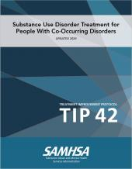


Slide 40
References/Resources
SAMHSA’s 2024 National Survey on Drug Use and Health
Claudia Black, Ph.D.
(De Bellis et al., 1999)
(Christine Curtois and Julian Ford, “Treating Complex Traumatic Stress Disorders,” 2009)
(Fallot & Harris, 2002;Cook et al., 2002; Ford, 2003; Cusak et al; Jennings, 1998;, Prescott, 2000).
Dual Diagnosis: An Integrated Model.. Kenneth Minkoff, M.D., 2002
K. Minkoff-”An Integrated Model for the Treatment of People with Co-Occurring Disorders in Managed Care Systems”
Co-occurring Disorders: A current review. Kessler, et al., 1994 Archives of General Psychiatry
SAMHSA/CSAT: Substance Abuse Treatment for Persons With Co-Occurring Disorders TIP 42, 2005
Gold, Mark. “Methamphetamine Psychosis and Schizophrenia”. Research You Can Use, January 11, 2018.
Pope, 1979., P.74
Clifton Mitchell, 2006
SAMHSA- http://modelprograms.samhsa.gov/
Society for Adolescent Substance Abuse Treatment Effectiveness (SASATE) http://www.chestnut.org
The National Institute of Drug Abuse (NIDA) www.nida.nih.gov
National Institute on Alcohol Abuse and Alcoholism www.niaaa.nih.gov.
The National Child Traumatic Stress network- www.nctsn.org.

Slide 41
Questions, comments, concerns??
Thank You!!!
Geoff Wilson, LCSW, LCADC, CCS
The Offices of Paul Dalton/Lexington Counseling & Psychiatry
501 Darby Creek, Suite 11
Lexington, KY 40509
859.229.5722
geoffwilson914@gmail.com

